Slide 1


BlueVault
Full Stack Banking Application
Team Members:
ANBU SAKTHI S
MADHAVAN S
HARRISH SHANKAR D
RAM PRASATH K

Slide 2






Project Overview
Full Stack Web Application
Complete end-to-end solution
Backend: Java Spring Boot
Robust REST API framework
Frontend: HTML, CSS, JavaScript
Responsive user interface
Database: MySQL
Secure data persistence
REST API Architecture
Scalable microservices design

Slide 3
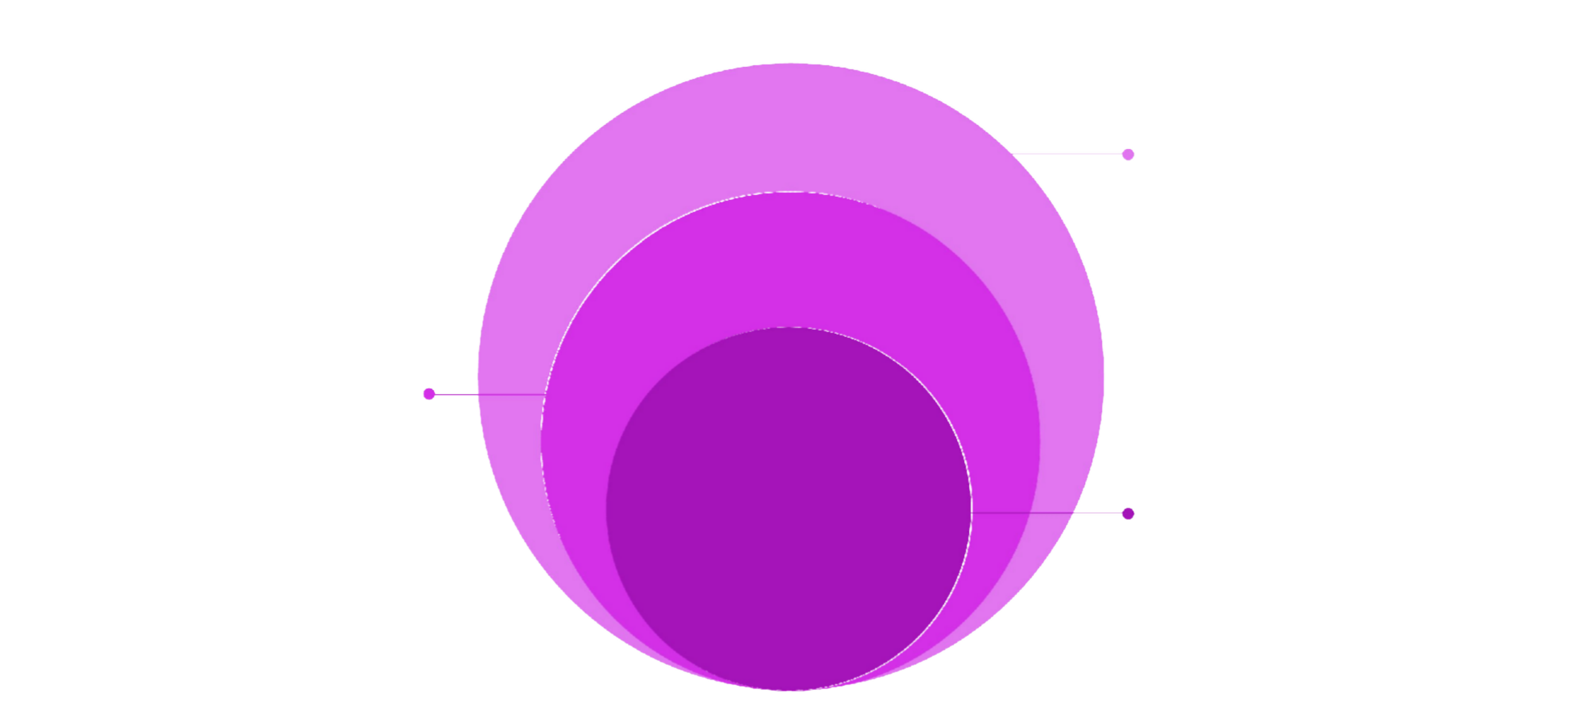
System Architecture
Service & Data Layer
Business logic, repositories, MySQL
Controller Layer
REST endpoints handling
requests
Frontend Layer
HTML/CSS/JavaScript interface
This diagram illustrates the clean and modular design of our system, ensuring scalability, maintainability, and clear separation of concerns for robust financial operations.

Slide 4






Backend Implementation
REST Controllers
Handle HTTP requests and responses efficiently.
Business Logic Layer
Encapsulates core application functionality and rules.
JPA / Hibernate
Robust object-relational mapping framework for data persistence.
MySQL Integration
Ensures reliable database connectivity and complex query execution.
Global Exception Handling
Centralized error management for a stable and resilient system.

Slide 5





Authentication & Security
JWT Authentication
Token-based stateless authentication
Stateless APIs
No server-side session storage required
Password Encryption
Bcrypt hashing for secure storage
Token Validation
Verify token integrity on each request
Secured Endpoints
Role-based access control (RBAC)

Slide 6
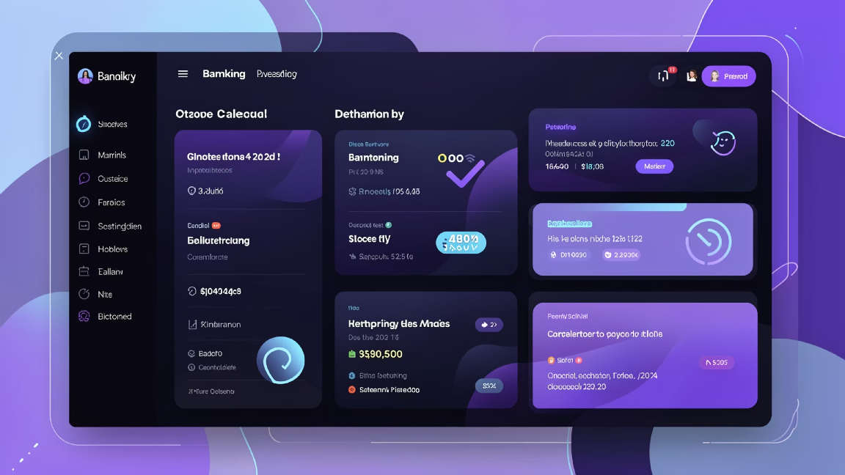






Core Functionalities
User Registration
Create new account with auto-generated account number
Secure Login
JWT-based authentication system
Auto Account Number Generation
Unique identifier per user
Balance Check
View current account balance
Fund Transfer
Secure money transfer between users
Transaction History
Complete transaction records and audit trail

Slide 7

API Structure
Base Endpoint:
/api/user/
•
•
•
•
•
POST /api/user/register
User registration and account creation
POST /api/user/login
Authentication and JWT token generation
POST /api/user/transfer
Secure fund transfer between accounts
GET /api/user/balance
Retrieve current account balance
GET /api/user/transactions
Fetch complete transaction history

Slide 8
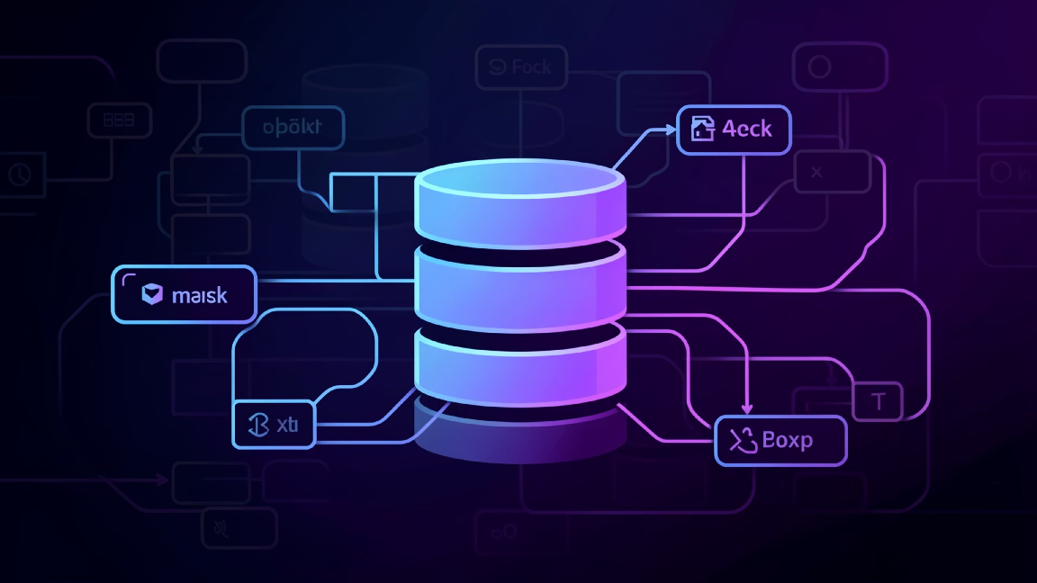





Database Design
Users Table
Stores user credentials and account information
Transactions Table
Records all financial transactions
One-to-Many Mapping
One user can have multiple transactions
Unique Account Number
Primary identifier for each account
Foreign Key Relations
Maintains referential integrity

Slide 9
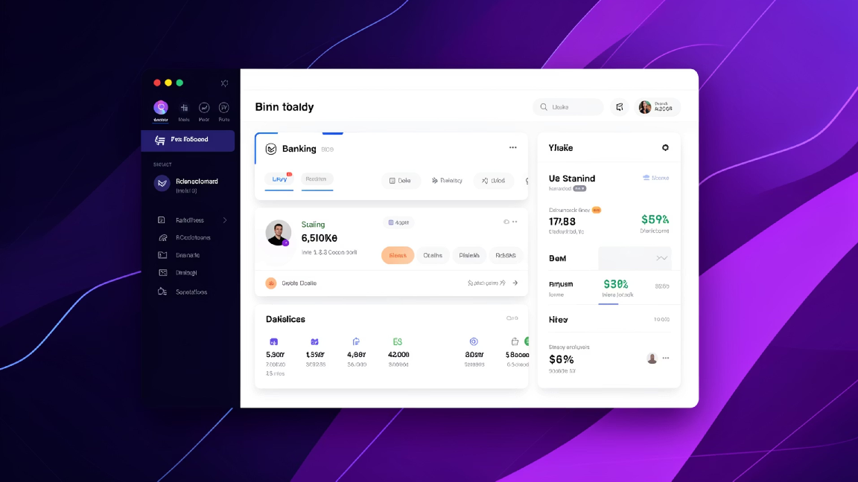





Frontend Implementation
Responsive UI Design
Mobile-first, adaptive layouts for optimal viewing across devices.
JavaScript Fetch API
Efficient handling of asynchronous HTTP requests for seamless data flow.
JWT in Local Storage
Secure persistence of authentication tokens for user sessions.
Dashboard Interface
Intuitive and user-friendly banking dashboard for easy navigation.
Form Validation
Client-side input validation and comprehensive error handling for data integrity.

Slide 10

Conclusion & Key Achievements
Complete Full Stack Implementation
End-to-end banking solution.
Secure REST Architecture
JWT-based authentication system.
Database-driven Transaction System
Reliable data persistence.
Scalable & Extendable Design
Ready for production deployment.
Our robust and forward-thinking architecture sets a new standard for secure and efficient digital banking experiences.

